Slide 1
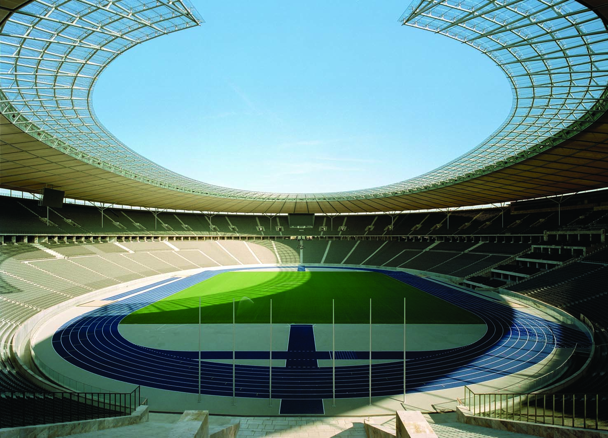
3
SUPPLY AND DEMAND II: MARKETS AND WELFARE

Slide 2
7
Consumers, Producers, and the Efficiency of Markets

Slide 3

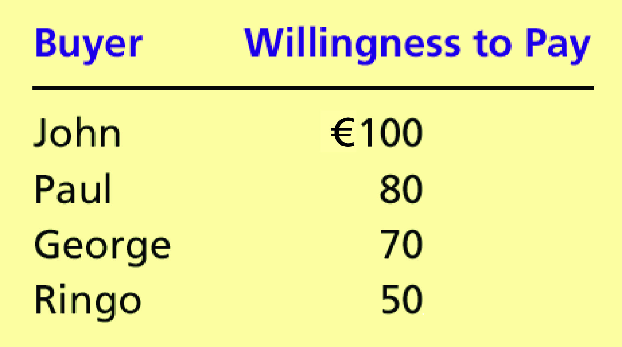
Table 1 Four Possible Buyers’ Willingness to Pay
Copyright©2004 South-Western

Slide 4
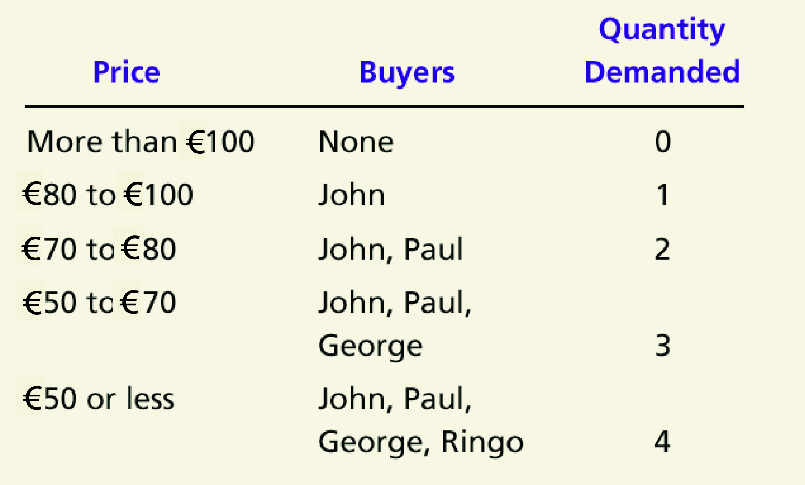
The Demand Schedule and the Demand Curve

Slide 5

Figure 1 The Demand Schedule and the Demand Curve
Price of
Album
€100
John
’
s willingness to pay
80
Paul
’
s willingness to pay
70
George
’
s willingness to pay
50
Ringo
’
s willingness to pay
Demand
0
1
2
3
4
Quantity of
Albums
Copyright©2003 Southwestern/Thomson Learning

Slide 6
Figure 2 Measuring Consumer Surplus with the Demand Curve
(a) Price = €80
Price of
Album
€100
John
’
s consumer surplus (€20)
80
70
50
Demand
0
1
2
3
4
Quantity of
Albums
Copyright©2003 Southwestern/Thomson Learning

Slide 7
Figure 2 Measuring Consumer Surplus with the Demand Curve
(b) Price = €70
Price of
Album
€100
John
’
s consumer surplus (€30)
80
Paul
’
s consumer
70
surplus (€10)
Total
50
consumer
surplus (€40)
Demand
0
1
2
3
4
Quantity of
Albums
Copyright©2003 Southwestern/Thomson Learning

Slide 8
Figure 3 How the Price Affects Consumer Surplus
(a) Consumer Surplus at Price
P
Price
A
Consumer
surplus
P₁
B
C
Demand
0
Q₁
Quantity
Copyright©2003 Southwestern/Thomson Learning

Slide 9
Figure 3 How the Price Affects Consumer Surplus
(b) Consumer Surplus at Price
P
Price
A
Initial
consumer
surplus
P₁
C
Consumer surplus
B
to new consumers
P₂
F
D
E
Additional consumer
Demand
surplus to initial
consumers
0
Q₁
Q₂
Quantity
Copyright©2003 Southwestern/Thomson Learning

Slide 10
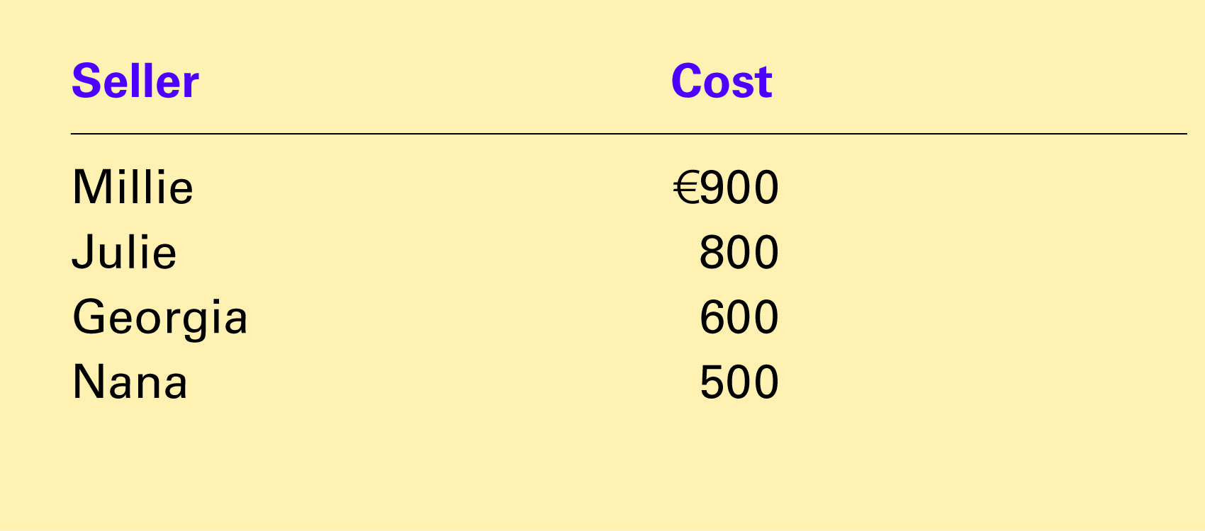
Table 2 The Costs of Four Possible Sellers
Copyright©2004 South-Western

Slide 11
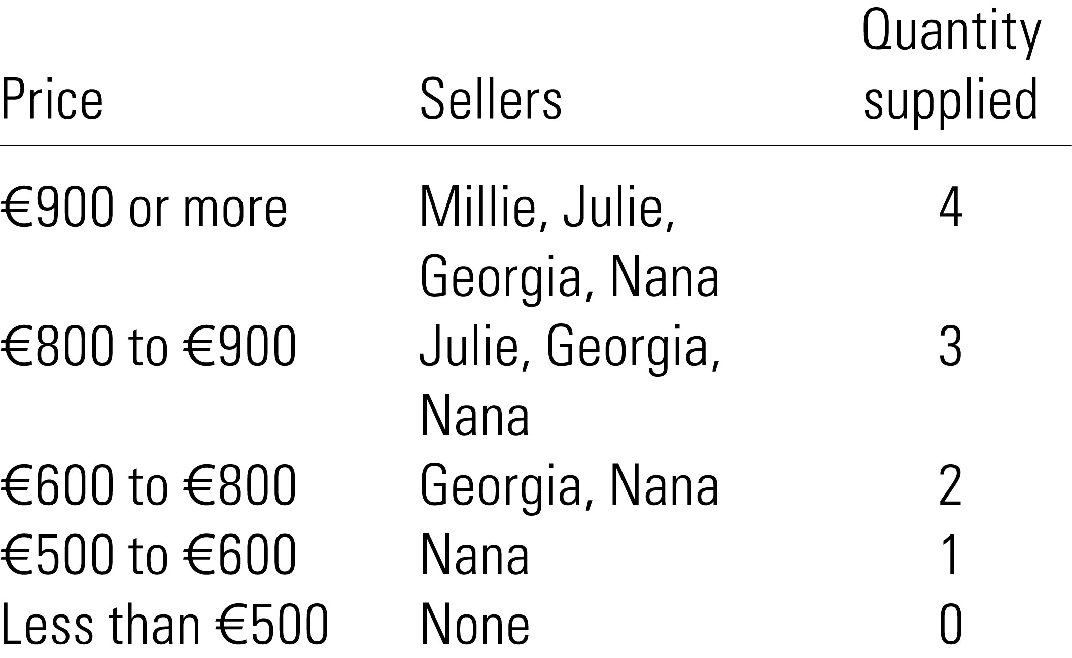
The Supply Schedule and the Supply Curve

Slide 12
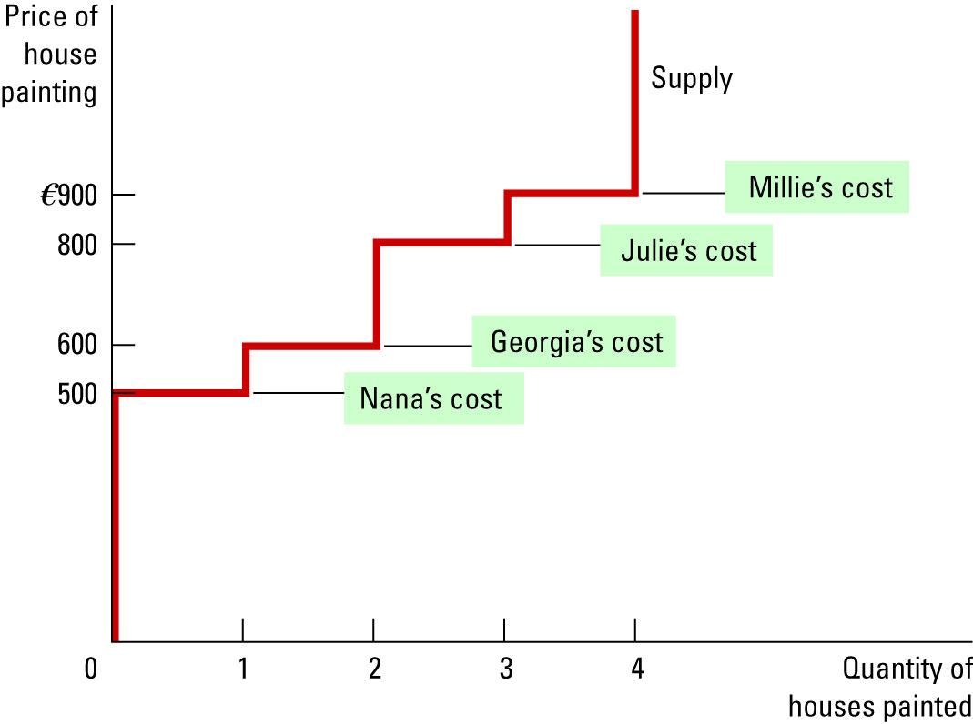
Figure 4 The Supply Schedule and the Supply Curve

Slide 13
Figure 5 Measuring Producer Surplus with the Supply Curve
(a) Price = €600
Price of
House
Painting
Supply
€900
800
600
500
Nana’s producer
’
surplus (€100)
0
1
2
3
4
Quantity of
Houses Painted
Copyright©2003 Southwestern/Thomson Learning

Slide 14
Figure 5 Measuring Producer Surplus with the Supply Curve
(b) Price = €800
Price of
House
Painting
Supply
Total
producer
€900
surplus (€500)
800
600
Georgia
’
s producer
500
surplus (€200)
Nana’s producer
’
surplus (€300)
0
1
2
3
4
Quantity of
Houses Painted
Copyright©2003 Southwestern/Thomson Learning

Slide 15
Figure 6 How the Price Affects Producer Surplus
(a) Producer Surplus at Price
P
Price
Supply
P₁
B
C
Producer
surplus
A
0
Q₁
Quantity
Copyright©2003 Southwestern/Thomson Learning

Slide 16
Figure 6 How the Price Affects Producer Surplus
(b) Producer Surplus at Price
P
Price
Additional producer
Supply
surplus to initial
producers
D
E
P₂
F
P₁
B
Initial
C
Producer surplus
producer
to new producers
surplus
A
0
Q₁
Q₂
Quantity
Copyright©2003 Southwestern/Thomson Learning

Slide 17
Figure 7 Consumer and Producer Surplus in the Market Equilibrium
Price
A
D
Supply
Consumer
surplus
Equilibrium
E
price
Producer
surplus
Demand
B
C
0
Equilibrium
Quantity
quantity
Copyright©2003 Southwestern/Thomson Learning

Slide 18
Figure 8 The Efficiency of the Equilibrium Quantity
Price
Supply
Value
Cost
to
to
buyers
sellers
Cost
Value
to
to
sellers
buyers
Demand
0
Equilibrium
Quantity
quantity
Value to buyers is greater
Value to buyers is less
than cost to sellers.
than cost to sellers.
Copyright©2003 Southwestern/Thomson Learning

